Slide 1


Rajalakshmi Engineering College
An Autonomous Institution
Affiliated to Anna University, Chennai
DEPARTMENT OF MECHATRONICS ENGINEERING
AUTOMATED MEDICINE DISPENSER WITH
PERSONAL HEALTHCARE MONITORING
UNIT USING IOT
TEAM MEMBERS
SUPERVISOR
Dr. Chandramohan P
( Professor)
Department of Mechatronics Engineering Rajalakshmi Engineering College
Deepak G (191201010)
Mohammed Asan Wazil A K (191201026)
Naveen Raj U M (191201029)

Slide 2
CONTENTS
Abstract
Introduction
Literature Review
Problem Statement
Objective
Methodology
Components
Block Diagram
Circuit Diagram
Design and dimension
Working
Results
Publication status
Reference

Slide 3
ABSTRACT
Nowadays medication for people in this fast-moving world is finding a tedious task taking the prescribed medication on time and the chance of consuming the wrong dosage and the possibility of missing the pill on time due to busy schedule which may result in slow recovery or side effects or even death.
So we came up with the solution to address the above stated problem by proposing the method of Automated medicine dispenser with health care monitoring System using IoT.
This proposed method is focusing on two major areas one is to dispense the pill for the patients at right time and other one is to measure the health parameters using various sensors at the instant moment.

Slide 4
INTRODUCTION
This project is designed with a microcontroller and actuator-based system to dispense the medicines at the right time with the prescribed amount of dosage and alert the users.
Also, this system provides notification regarding whether the patient has taken the pill at the right time and alerts about running out of medicines using an ultrasonic sensor.
This project also includes basic human parameters like Blood pressure (BP), Temperature can also be measured through this machine with the help of respective sensors.
Overall our project has the potential to greatly improve the lives of older patients and those with chronic diseases by helping them manage their medication and health more effectively

Slide 5
PROBLEM STATEMENT
Nowadays medication for people in this fast-moving world is finding a tedious task taking the prescribed medication on time and the chance of consuming the wrong dosage and the possibility of missing the pill on time which may result in slow recovery or side effects or even death.
In case of elder people or paralyzed patients they need an attender to take care of them . Due to the lack of time people used to skip their food for urgent work and also living an unhealthy life by eating unhealthy food. it, may lead to serious health issues and later result in death.
So the Automated Medicine Dispenser With Healthcare Monitoring Using IoT can aid to resolve the mentioned requirement.

Slide 6
LITERATURE SURVEY
S.No | TITLE OF THE RESEARCH PAPER | INFERENCE ABOUT THE PAPER
1. | AUTOMATED MEDICINE DISPENSER IN PHARMACY Author: Dr. Sivakumar S.A , N.G.P Institute Of Technology - Coimbatore | Automatic medicine dispensers are designed specifically to reduce manpower and shopping time in the pharmacy.Hence this project mainly concentrates to avoid the problem. The purpose of the experiment is to deliver the medicine to the customer in a minimum time
2. | DESIGN AND IMPLEMENTATION OF AUTOMATIC MEDICINE DISPENSING MACHINE Author: Mahaveer Penna, Dankan V Gowda, Jijesh J J, Shivashankar, | The scope of its implementation can be extended to many physical locations where no pharmacy is existing, anyone can access this system by providing input of their choice through a keypad or any other input device and can avail medicines through automatic microcontroller based motor system,.

Slide 7
S.No | TITLE OF THE RESEARCH PAPER | INFERENCE ABOUT THE PAPER
3. | DESIGN OF AUTOMATED MEDICINE VENDING MACHINE USING MECHATRONICS TECHNIQUES Author: A Brolin, R Mithun, V Gokulnath and M Harivishanth | An automatic medicine vending machine with a self-contained on-site pill dispensing mechanism and a storage facility for the plurality of pills that can be dispensed based on the user’s requirement. It also holds an inbuilt system to receive money from the user for the drugs that are dispensed.
4. | LOW-COST ROBOTIC MEDICINE DISPENSER Author: Mohammad Auzi Ahadani, Liyanage C. De Silva , Iskandar Petr, Mohammad Faisal A. Hameed A , Teck Sion Wong | In this paper, the design of a low cost scalable hands-free robotic medicine dispenser is introduced. The prototype is tailored for the use of pharmacists as it automates the process of counting and dispensing tablets and capsules.

Slide 8
OBJECTIVE
The main objective of this project is to help old aged persons or patients to take their medicines on time without any assistance from the other person.
so that they won't be able to get forgotten about their medicines and count on it the and to have live monitoring of the healthcare of regular checks like blood pressure and sugar monitoring systems using the Internet of Things.
The system is designed to be user-friendly, and doctors can easily access live updates on the patient's health through a web application. This feature allows healthcare providers to monitor the patient's health, review their medical reports, and check the medicine dispenser's stock

Slide 9
METHODOLOGY
The methodology of the proposed project utilizes a microcontroller, which is a small computer on a single integrated circuit, to control the dispensing of medication with the movement of servo motor allowing the system to dispense the correct amount of dosage at the prescribed time and alert the users through the buzzer.
Also, this system is designed to provide notifications message to the user regarding whether or not the medication has been taken at the prescribed time as well as alerts about running out of medication using an ultrasonic sensor.
The project incorporates IoT technology to measure basic human parameters such as blood pressure and SpO2 using a pulseoximeter.

Slide 10
METHODOLOGY CONT.
This pulse oximeter uses infrared light to measure the amount of oxygen in the blood and the pulse rate, which can be used to calculate blood pressure and also measure the temperature, humidity using respective sensors.
The data collected from these measurements can be used to monitor the patient's health and provide valuable insights for healthcare professionals.
The system could also be connected to remote monitoring system which will allow healthcare professionals or family members to monitor the patient’s health remotely and get notified if there is any emergency.
The system can be customized to set reminders for different medications, different time, different days which will help to ensure the compliance of the patient.

Slide 11
COMPONENTS
Arduino MEGA
DS3231 RTC Module
Lcd 20 x 4 display
I2C Module
4X4 Keypad
Servo motor
Buzzer
ESP8266
Heart Rate pulse senor
DS18B20 one wire waterproof sensor
DHT22 Humidity Sensor
Connecting wires
12v Adapter and Lithium ion battery

Slide 12
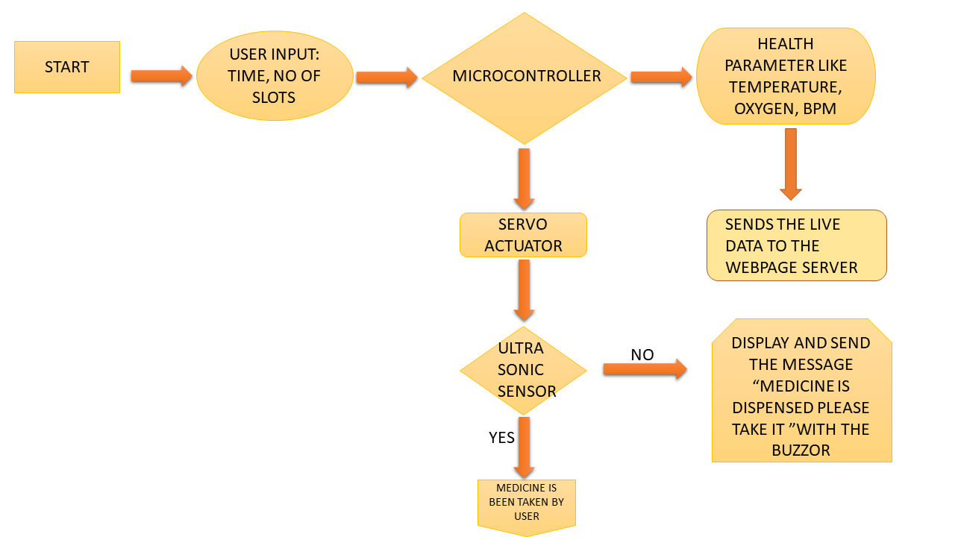
BLOCK DIAGRAM

Slide 13
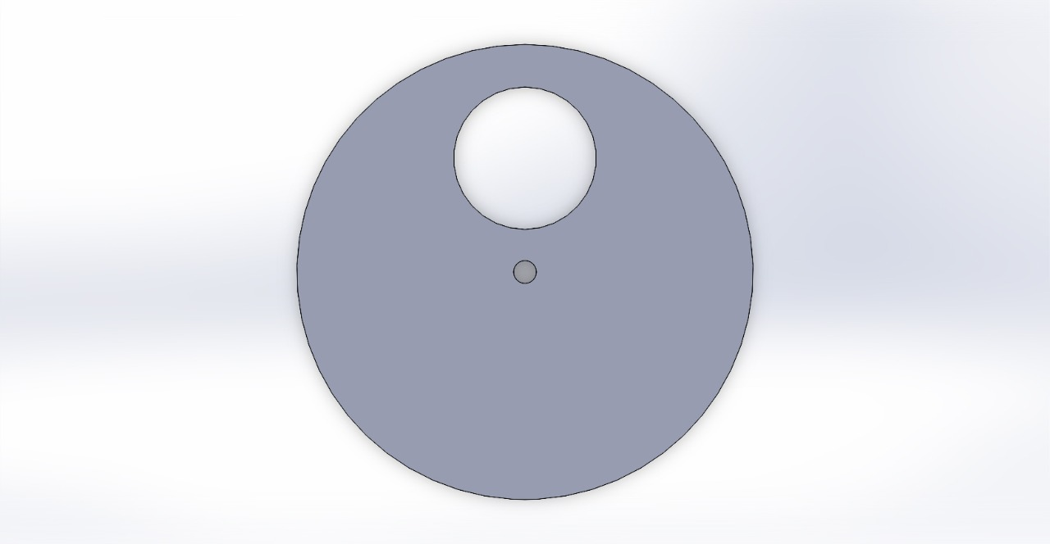
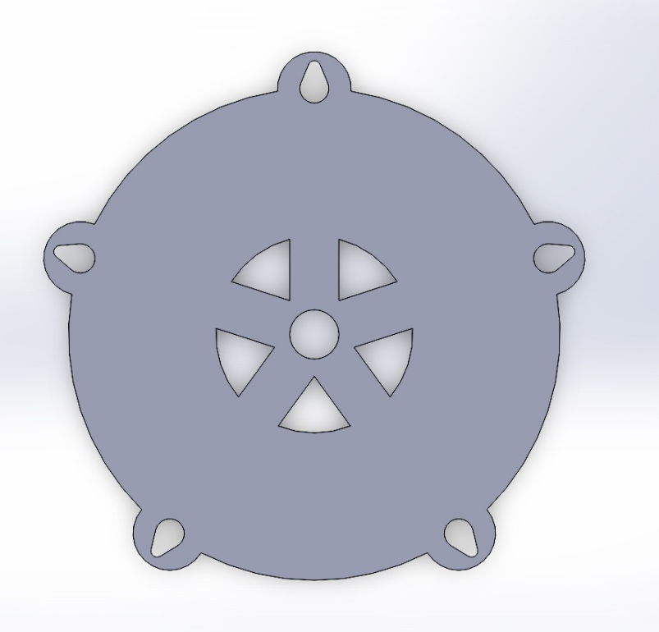
INTERIOR DESIGN
Slider:
Dimensions
Exterior Radius: 5cm
Interior Radius: 1cm
Central Rim:
Exterior Radius : 20 cm

Slide 14
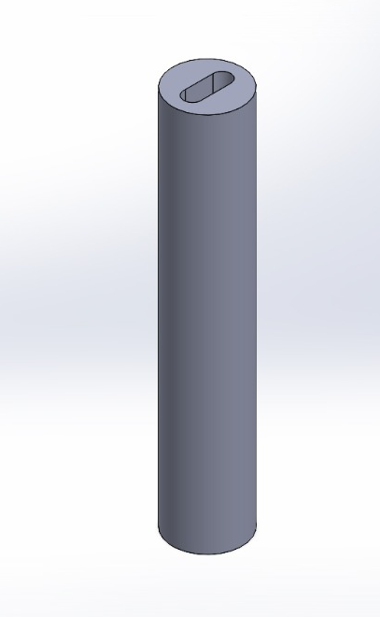
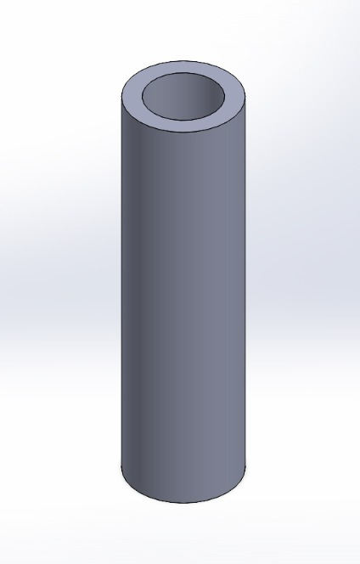
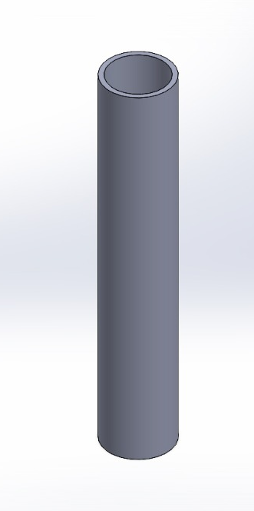
INTERIOR DESIGN
Long Capsule slot
Length : 10cm
Capsule module
Length : 1.7 cm
Round Capsule Slot 1
Length : 10cm
Capsule diameter : 3cm
Round Capsule slot 2
Length : 10 cm
Capsule Diameter : 3.4cm

Slide 15
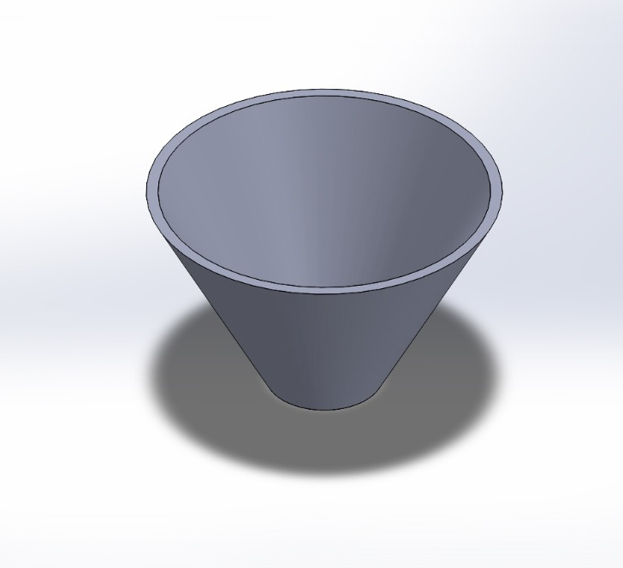
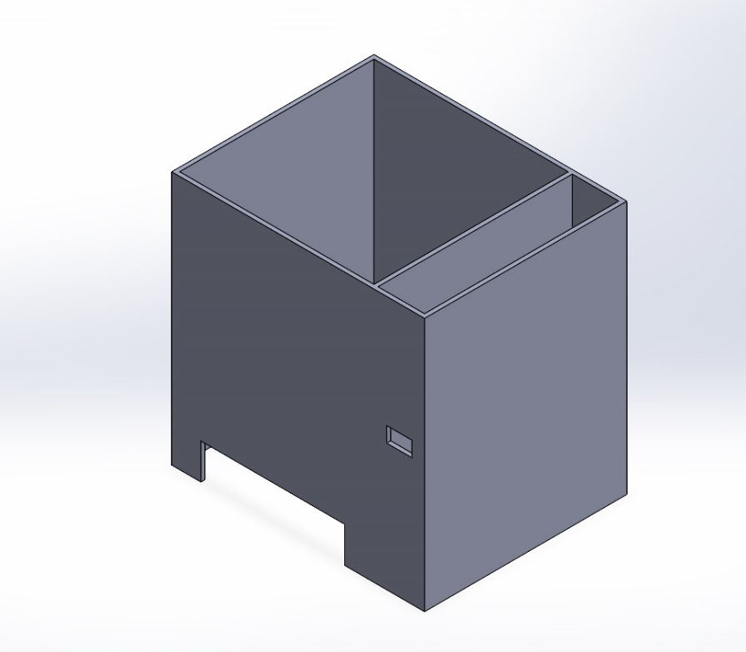
EXTERIOR DESIGN
INTERIOR DESIGN
Outer Box :
Full Dimensions: 50*40*50 cm
Tablet receiving slot: 7*28.4 cm
Sensor Slot : 5*3 cm
Tablet Collecting Slot
Bottom Diameter : 14cm
Top Diameter : 25 cm

Slide 16
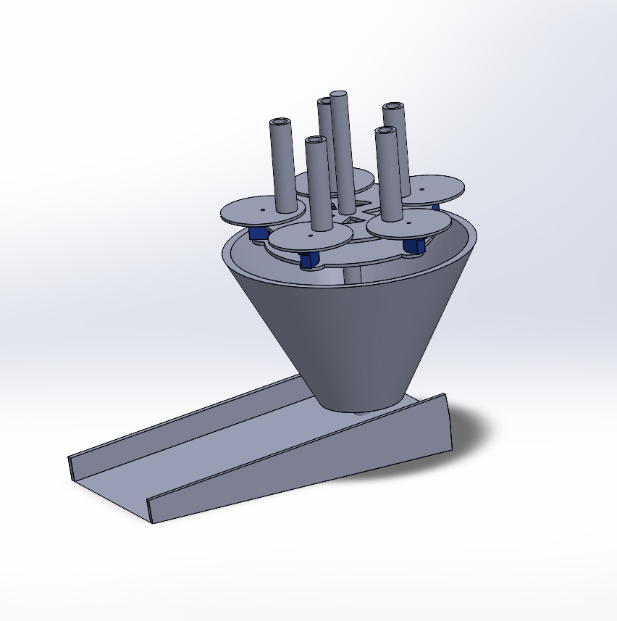
INTERIOR ASSEMBLY

Slide 17
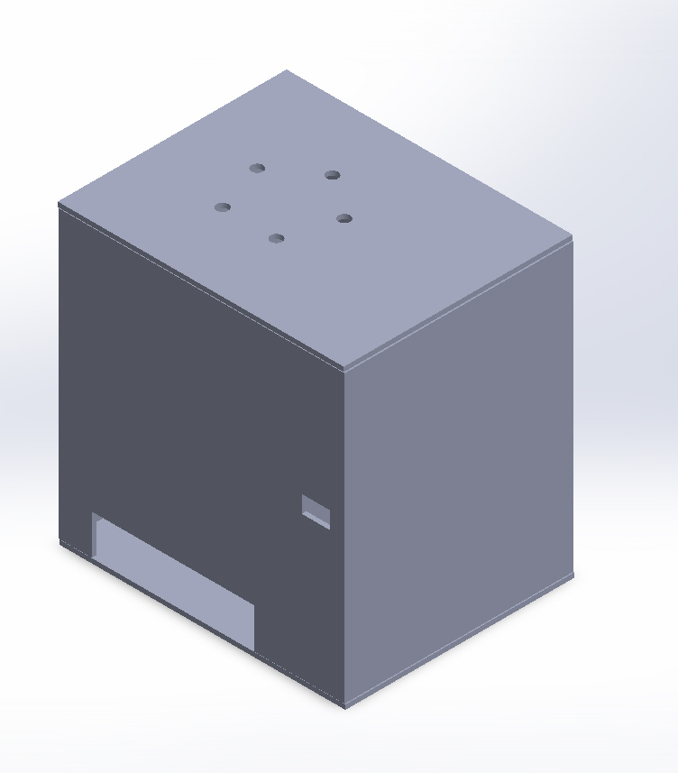
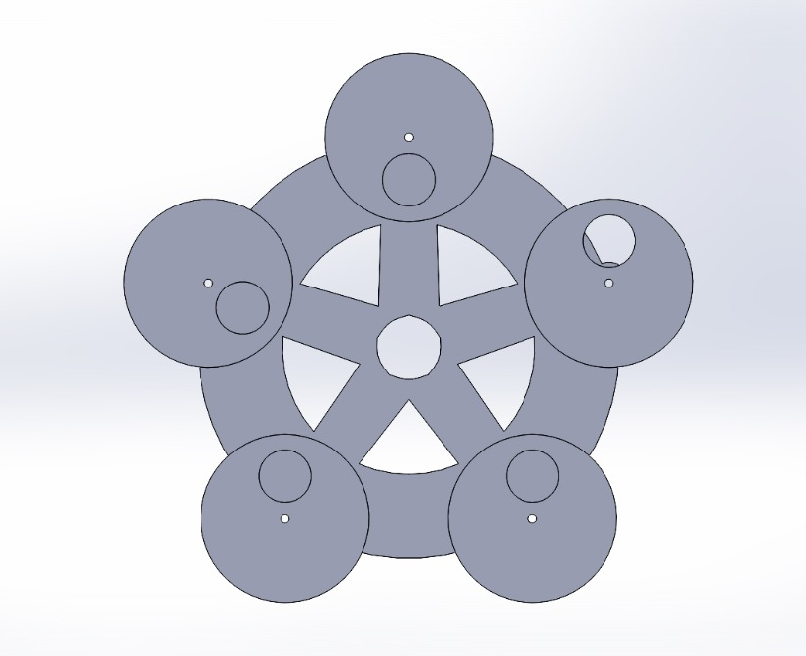
Assembled Diagram

Slide 18
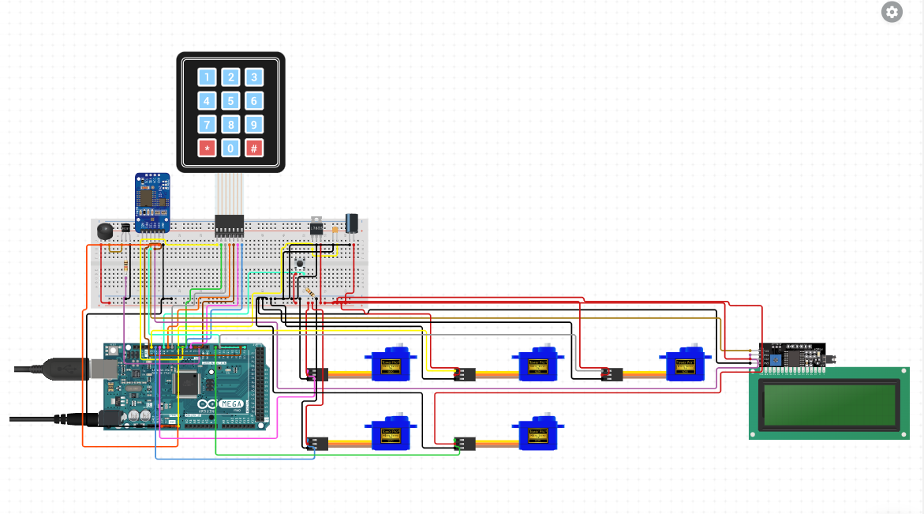
CIRCUIT DIAGRAM

Slide 19
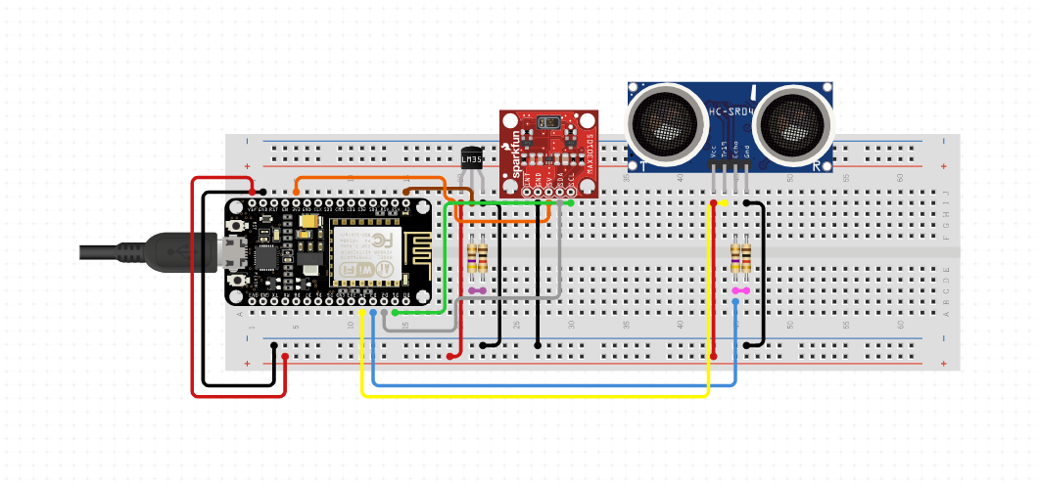
CIRCUIT DIAGRAM

Slide 20
WORKING
The medicine dispenser works as per the doctor setting the timing and the slots for the patient. The medicine dispenser contains five slots and each slots has different tablets.
Based on the time schedule and the slot selection the tablets has been dispensed in the machine. This timing and slot selection can be modified has per patient requirement.
Additionally we are interfacing the human interfacing health monitoring system to check the daily conditions of the patient. This data has been publish in the web page and the patient can view the details. The data of the patient will be also send to Iot cloud and the doctor can view the details of the patient simultaneously.

Slide 21
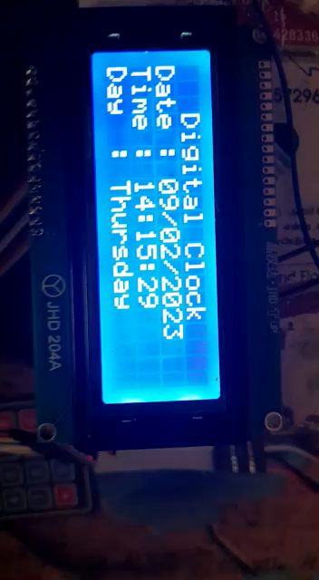
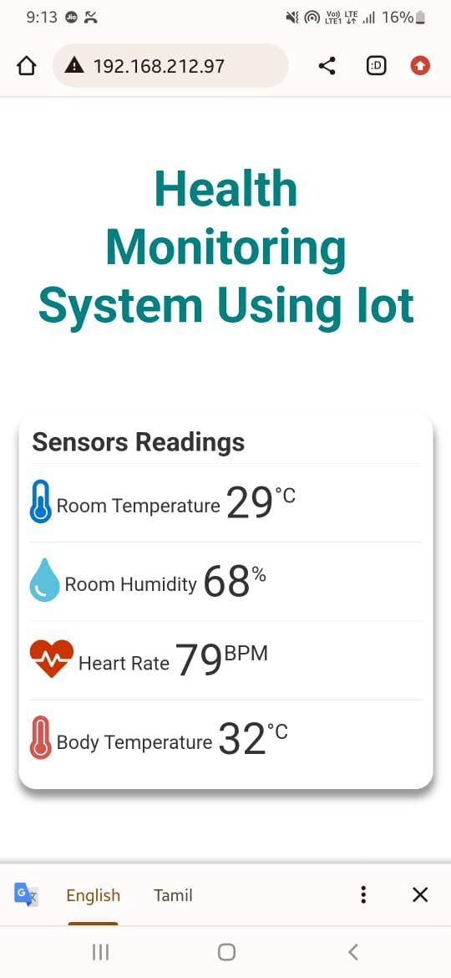
RESULT

Slide 22
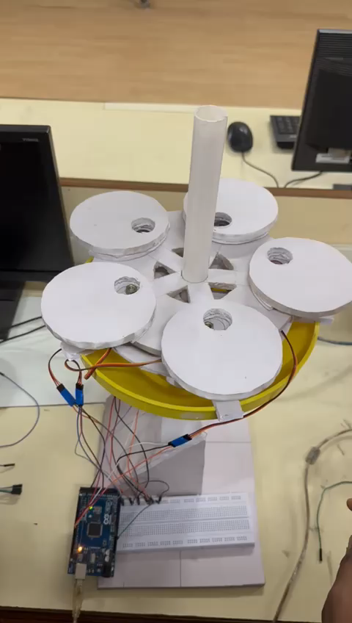
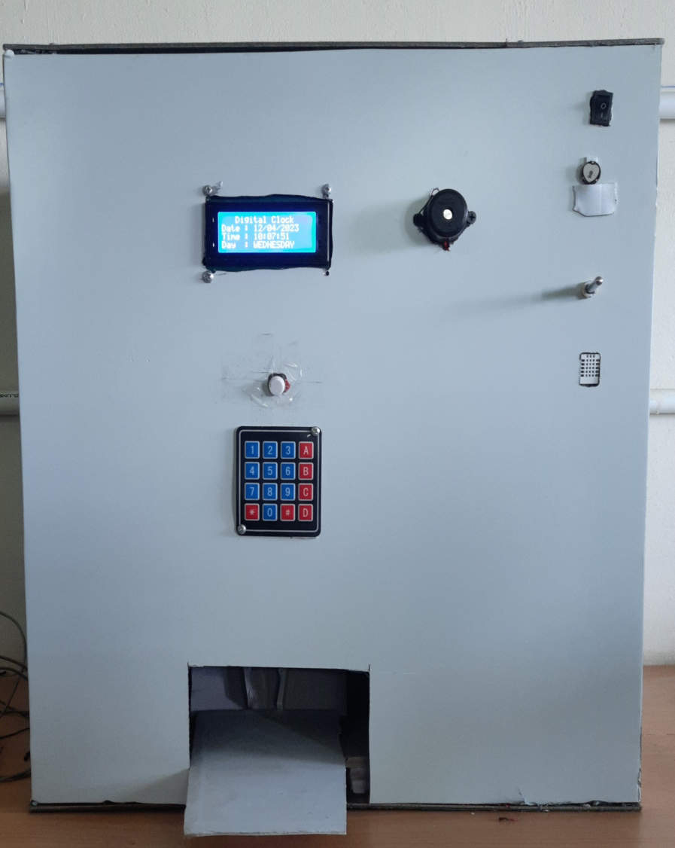
RESULT

Slide 23
CALCULATIONS
OUTER FRAME CALCULATIONS:
The length of the box = 50cm.
The breadth of the box= 40 cm.
The height of the box = 50 cm.
Total surface area required = 2[l*b + b*h + h*l]
= 2[(50+50)+(40*50)+(50*50)]
= 13000cm² = 14ft².
Volume of the Medicine Dispenser = L*B*H.
= 50*40*50
= 1000000cm³.
Length Of the Frame =
= 15+0.8+0.8+3+0.8+18+12
= 49.6 ~ 50cm.
Height of the slot+ Thickness of the slider+ Thickness of the Central Disk+ Servo Height + Thickness of the Base disc+ Height of the Frustum + Tablet collector height.

Slide 24
CALCULATIONS
Total No of slots = 5
Average thickness of the tablet = 0.45cm.
Average Diameter of the tablet = 1.2 cm.
Length of the slot = Thickness of the tablet* No of the tablet.
= 0.45*25=11.25 ~ 13cm.
Hence the Length = 15cm.
Outer Diameter of the slot = 1.5cm.
Inner diameter of the slot = 1.2cm.(Diameter of the Tablet).
CENTRAL DISK CALCULATIONS
Diameter of the disc = 20cm.
Circumference of the disc = 2*π*r.
= 2*π*10=62.83cm.
Distance between each slot = Circumference of the Disk/ No of slots.
= 62.83/5= 12.56cm
The Angle Between Each Slot = 360/5 = 72°.

Slide 25
CALCULATIONS
SLIDER CALCULATION:
Inner Circle diameter = 1.2cm.
outer circle radius =
=1.2+0.5+0.6=2.3 ~ 2.5cm.
Diameter of the Outer Circle = 5cm.
The Circumference of 1 Slider = π*r.
= π*2.5=7.85cm.
Circumference of the 5 sliders = 5*7.85 = 39.25cm.
Distance Between each Slider =
= 32.83-39.25/5.
= 4.7cm.
SERVO MOTOR CALCULATIONS:
Operating Speed = Required Angle/ Delay.
= 140/10 = 14° delay.
Diameter of the inner circle + Diameter of servo Shaft + Radius of the inner circle.
circumference of the disc-Circumference of the 5 slider / 5.

Slide 26
CALCULATIONS
DEFLECTION OF THE CENTRAL DISK:
ρ = 30
g = 0.29N.
E = 2.6*10⁹ N/M².
L = 20cm = 0.2m.
I = πr⁴/4.
=π*(0.1)⁴/4.
=0.00008m⁴.
Deflection = δ = WL³/3EI.
= 0.29*0.2³/3*2.6*10⁹*0.00008
= 0.00232/624000
= 4*10⁻⁹m.

Slide 27
PUBLICATION STATUS
The Review paper has been sent to the Publication of IEEE Conference “ICONSTEM” At Jeppiar Engineering College.
We attended the Conference on the 6th of April 2023.

Slide 28
REFERENCE
[1] Islam, SM Riazul, et al. “The internet of things for healthcare: a comprehensive survey.” IEEE Access 3 (2015): 678-708.
[2] Sivakumar S.A “Automated Medicine Dispenser in Pharmacy” International Journal of Advances in Computer and Electronics Engineering Volume 4, Issue 8, August 2019, pp. 6-11
[3] Wissam Antoun, Ali Abdo and Suleiman Al-Yaman “ Smart Medicine Dispenser (SMD) ” 2018 IEEE 4th Middle East Conference on Biomedical Engineering (MECBME)
[4] Mahaveer Penna, Dankan V Gowda, Jijesh JJ, Shivashankar “Design and Implementation of Automatic Medicine Dispensing Machine” 2017 2nd IEEE International Conference On Recent Trends In Electronics Information & Communication Technology (RTEICT),
[5] Rouse, Margaret. MQTT Protocol Communication. https://internetofthingsagenda.techtarget.com/definition/ MQTT-MQ-Telemetry-Transport . 13 April 2018
[6] Islam, S M Riazul, et al. “The internet of things for health care: a comprehensive survey.” IEEE Access 3 (2015): 678-708.

Slide 29
THANK YOU

